Slide 1


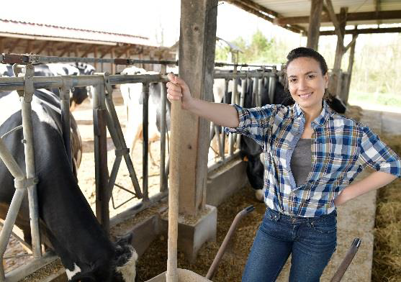
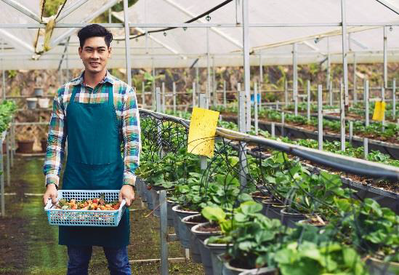

Agricultural & Horticultural Work Experience In Germany ,Australia & U.S.A.

Slide 2
Internship /Work Experience Fields
Animal Production
Stock Breeding
Greenhouse Management
Vegetable Production
Flower Production
Ecology
Agronomy
Mechanization
Veterinary
Dairy Farm
Horse Farm
And other agriculture related branches

Slide 3
Work from 6 Months to 12 Months In International Environment .
Earn Rs.60,000/- To 1,50,000/- Per Month.
Free Accommodation, Food etc.
*Learn Foreign Language.
*100 % Fee Cashback

Slide 4
Why Do Work Experience at International Level ?
Personal, Academic, And Professional Growth.
Jumping into a new culture is not easy, but a challenge well-worth undertaking. Great things happen outside of comfort zones. You will push the boundaries of what you’re capable of and grow in independence, giving you confidence to take on even bigger challenges in the future. These inter-cultural learning experiences lead to personal, academic, and professional development.

Slide 5
Why Do Work Experience at International Level ?
Expand Your Global Network
An international internship will provide you with the opportunity to build a global network. This can introduce you to an entirely new network, and influential industry experts. You will also meet like-minded individuals from all over the world, who will be undertaking the same experience as you, which can lead to friendships that will last a lifetime, something which is invaluable for your future. More importantly, you will become a master at networking and sparking up friendships with people from all walks of life – a priceless asset to have.

Slide 6
Why Do Work Experience at International Level ?
Career Evaluation
A perfect way to experience and experiment a career field without making a serious commitment is through an internship abroad. You can gain insight into what it would be like to work in an industry and personally evaluate yourself to see if you’re a great fit. Even if you decide that the career field or industry is not right for you, you will learn a whole range of transferrable skills that will leave a great impression on any potential future employer, and you will have a clearer idea about where you see yourself in the future.

Slide 7
Why Do Work Experience at International Level ?
Become a Global Citizen Living an experience abroad will also expand your cross-cultural understanding and increase your global awareness and understanding the impact of global trends on local economies and local communities, this will enable you to better understand your cultural values and beliefs in a new context and also understand and respect others.

Slide 8
Why Do Work Experience at International Level ?
Earn Academic Credit & Fulfill Academic Goals
Most universities will accept an internship abroad to support your academic credit and it can also form part of your university thesis. So, if you’re still at university you can connect an international internship experience to your academic life and goals.

Slide 9
Contact For More Details.
A : Shop No C, Commercial House,Jupitor CHS
Nr Ganesh Temple,Kalyani Nagar
Pune, India 411014
# +91 20-48601029 # +91 9325656756
# +91 9922514719
www.travelogimmigration.com

